Slide 1
Object-Oriented Programming (OOP) in Python:
Object-Oriented Programming (OOP) is a programming paradigm that organizes code around objects and classes. It is one of the most widely used approaches in Python due to its ability to create reusable and modular code.
Key Concepts of OOP:
OOP in Python revolves around four main principles:
Class & Object
Encapsulation
Inheritance
Polymorphism
Abstraction

Slide 2
Class and Object:
1️⃣ What is a Class?
A class is a blueprint for creating objects. It defines attributes (variables) and behaviors (methods) that objects of the class will have.
2️⃣ What is an Object?
An object is an instance of a class. Each object can have its own data while sharing the same structure (class).

Slide 3
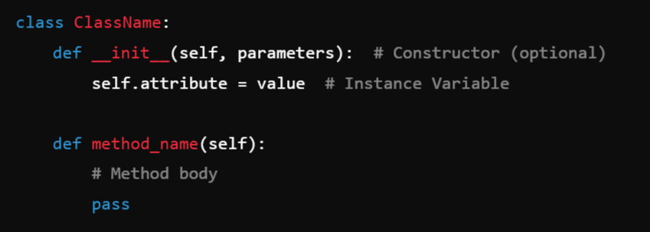
Syntax: Defining a Class

Slide 4
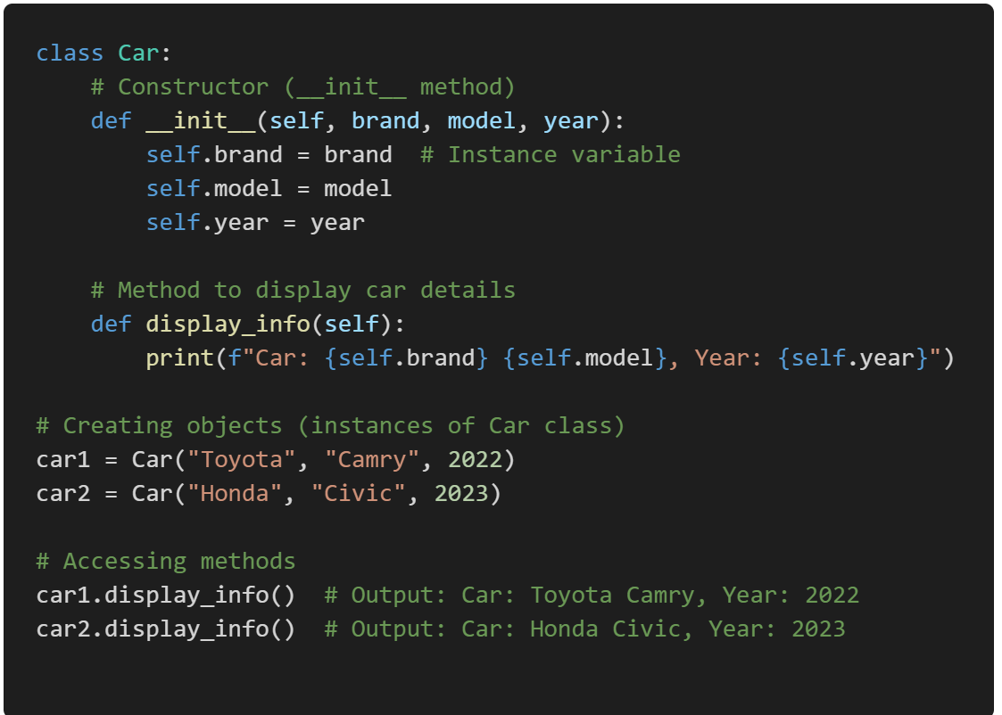
Example: Creating a Class and Objects

Slide 5
Explanation:
Class Definition (class Car): Defines a class named Car.
Constructor (__init__ method):
This is a special method that runs when an object is created.
It initializes instance variables (self.brand, self.model, self.year).
Instance Variables (self.brand, self.model, self.year):
These are attributes specific to each object.
Methods (display_info):
This method prints the car details.
Creating Objects (car1, car2):
Two instances of the Car class are created with different values.
Calling Methods (car1.display_info()):
Each object calls the display_info() method to print its details.

Slide 6

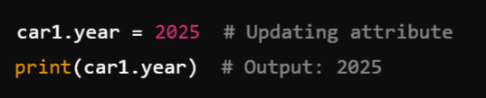
Accessing Class Attributes and Methods:
Example: Accessing Attributes:
Modifying Attributes:

Slide 7
Class Variables vs Instance Variables:
Instance Variables (self.attribute) → Unique to each object.
Class Variables (ClassName.attribute) → Shared by all objects.

Slide 8
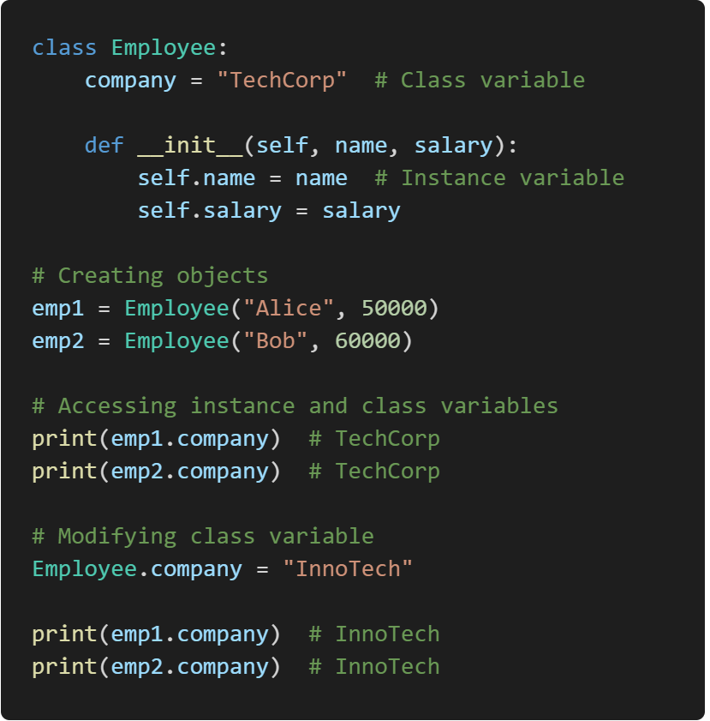
Example: Class vs Instance Variables
company is a class variable, shared across all instances.
name and salary are instance variables, unique to each object.
Changing Employee.company affects all instances.

Slide 9
Instance Methods, Class Methods, and Static Methods:
Python supports 3 types of methods in a class:
1️⃣ Instance Methods (Operate on Object Data)
2️⃣ Class Methods (Operate on Class Variables)
3️⃣ Static Methods (Independent of Class and Instance)

Slide 10
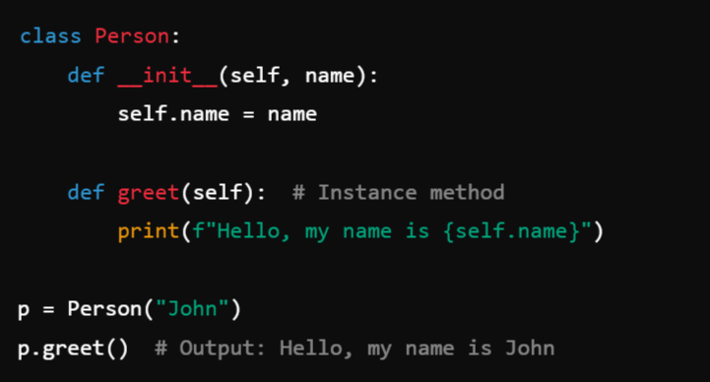
1️⃣ Instance Methods (Operate on Object Data):

Slide 11
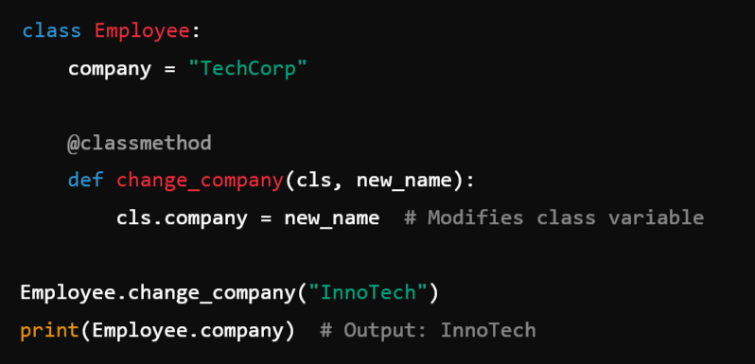
2️⃣ Class Methods (Operate on Class Variables)

Slide 12
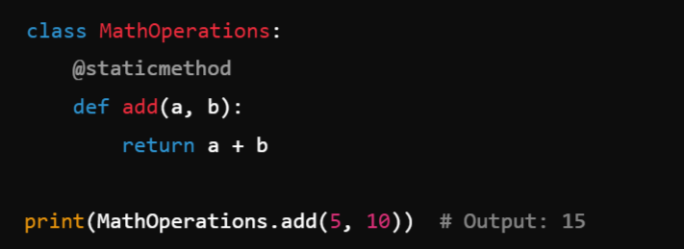
3️⃣ Static Methods (Independent of Class and Instance)
Static methods in Python are independent of both class instances (objects) and the class itself’s state. That’s why they don’t take self or cls as the first argument.

Slide 13
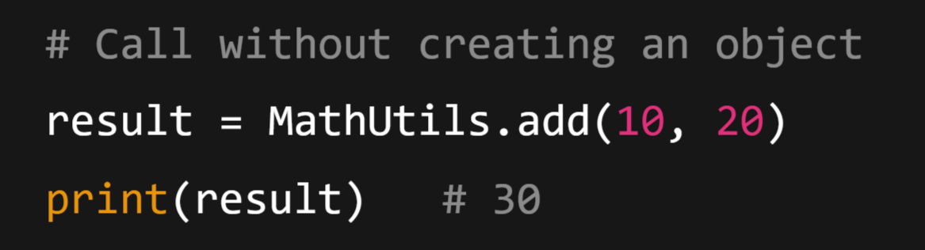
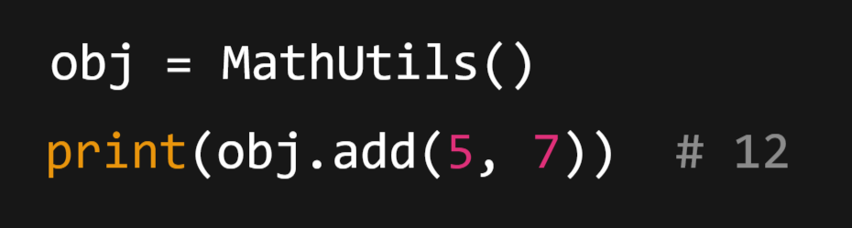
You can call a static method in two ways:
Call using the class name (preferred)
Call using an object instance (also works, but not common)

Slide 14
Can We use any One type of Method to achieve all?
Technically, yes, can use any one type of method to achieve the functionalities of all three, but it may not be ideal in terms of design and readability.
Best Practice: Use the Right Tool for the Job
1️⃣ Instance Methods → When working with instance attributes or Variables.
2️⃣ Class Methods → When working with class-level data.
3️⃣ Static Methods → When the method is independent of the class and instance (object).

Slide 15
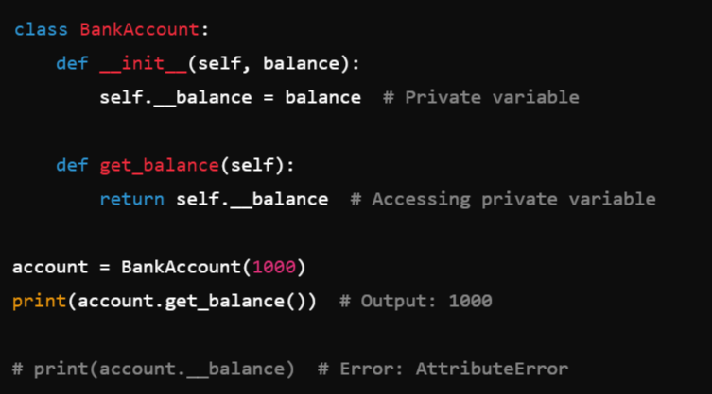
2. Encapsulation (Hiding Data):
Encapsulation restricts direct access to object attributes or variables by making them private.
Example: Private Variables (__variable)
Note: Private variables are prefixed with __ and cannot be accessed directly.

Slide 16
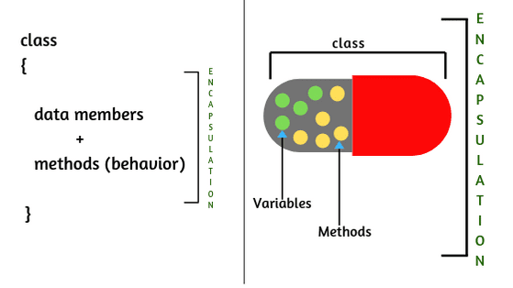

Slide 17
Encapsulation Implementation (Java & Python):
1. Making the attributes Private (Using __)
2. Using Getters and Setters to access and update the private attributes
Application of Encapsulation:
Security
Modularity

Slide 18
Constructors:
A constructor is a special method in Python used to initialize objects when they are created. The constructor is defined using the __init__() method inside a class.
1️⃣ What is a Constructor?
It automatically called and executed when an object of the class is created.
Used to initialize instance variables.
Starts with def __init__(self, ...) where self represents the instance of the class.

Slide 19
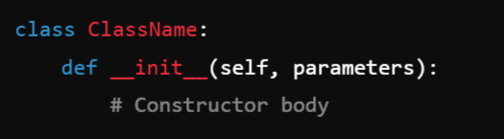
2️⃣ Syntax of a Constructor:

Slide 20
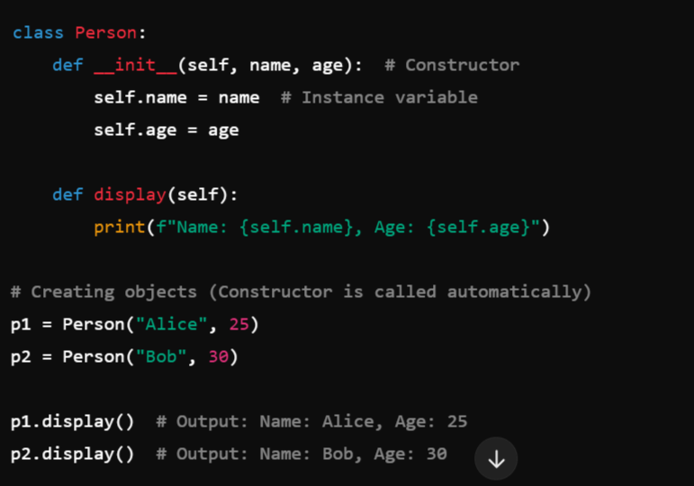

3️⃣ Example: Constructor in a Class:

Slide 21
4️⃣ Types of Constructors in Python:
Python supports 3 types of constructors:
Default Constructor
Parameterized Constructor
Constructor with Default Values

Slide 22
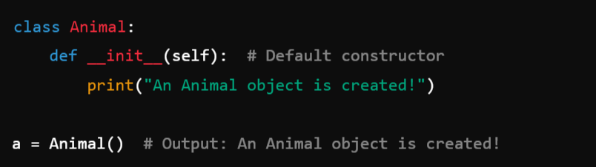
1️⃣ Default Constructor (No Parameters):
A default constructor does not take any arguments except self.
The constructor is executed automatically when a is created.

Slide 23
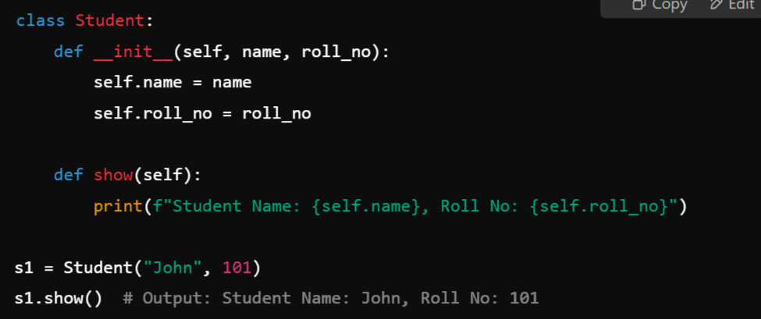

2️⃣ Parameterized Constructor:
A parameterized constructor accepts arguments to initialize object attributes.
The constructor initializes name and roll_no with values provided during object creation.

Slide 24
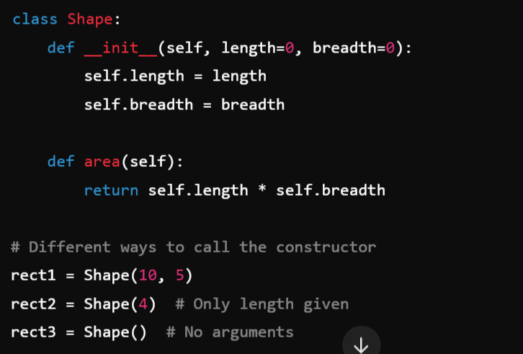

3️⃣ Constructor with Default Values:
A constructor can have default parameter values.

Slide 25
Poly-morphism:
Poly - many
Morphism – forms
Types of Polymorphism:
Compile Time (Early Binding)
Method Overloading
Operator Overloading
Constructor Overloading – Not supported in Python
Run Time: (Late Binding)
Method Overriding

Slide 26
Constructor Overloading in Python
Python does not support constructor or Method overloading (like Java or C++) because Python allows only one __init__ method in a class.
However, you can achieve similar behavior using:
1️⃣ Default Arguments
2️⃣ Variable Arguments (*args and **kwargs)
3️⃣ Multiple Constructors using Class Methods

Slide 27
3. Inheritance:
Inheritance is an object-oriented programming (OOP) concept where a class (child class) derives properties and behaviors (methods) from another class (parent class). This helps in code reusability and reducing redundancy.
1️⃣ What is Inheritance?
It allows one class (child/derived class) to inherit attributes or variables and methods from another class (parent/base class).
Enables code reusability and hierarchical relationships between classes.

Slide 28
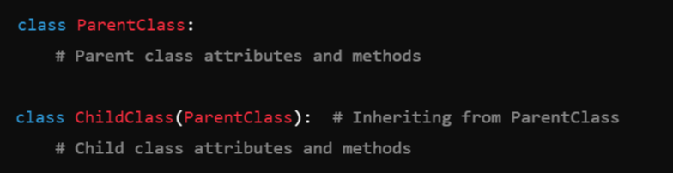
2️⃣ Syntax of Inheritance:

Slide 29



3️⃣ Types of Inheritance in Python:
Single Inheritance
Multiple Inheritance
Multilevel Inheritance
Hierarchical Inheritance
Hybrid Inheritance

Slide 30
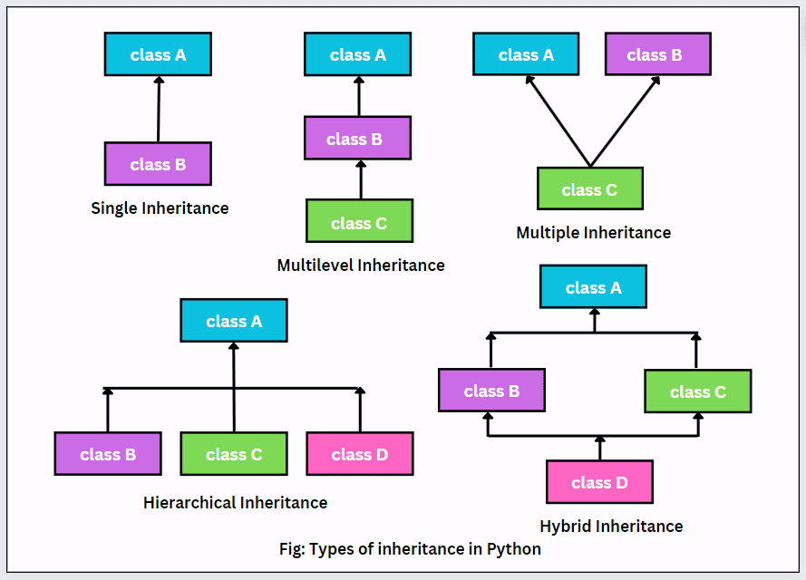

Slide 31
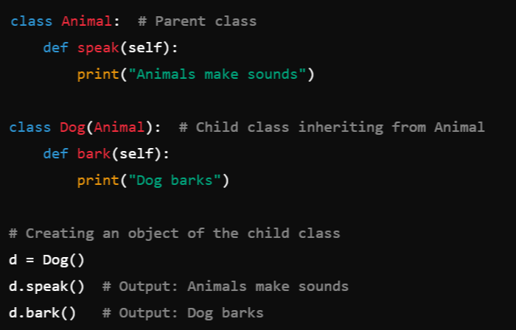
Single Inheritance:
In single inheritance, a child class inherits from a single parent class.
Example:
The Dog class inherits the speak() method from the Animal class.

Slide 32
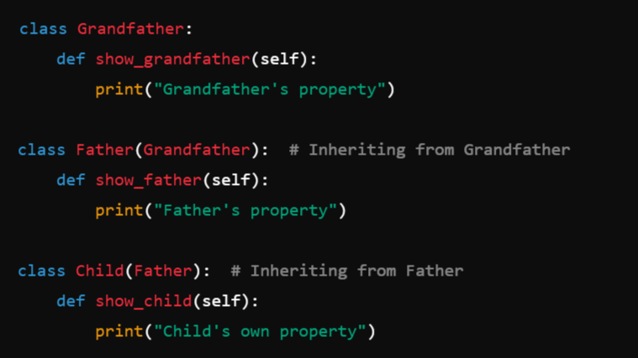
2. Multilevel Inheritance:
In multilevel inheritance, a class inherits from another derived class.
Example:

Slide 33
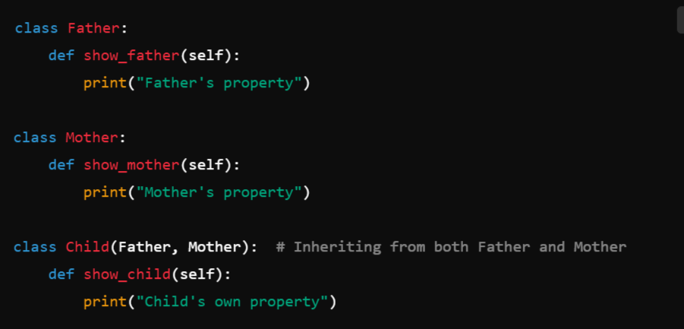
3. Multiple Inheritance
In multiple inheritance, a child class inherits from more than one parent class.
Example:

Slide 34
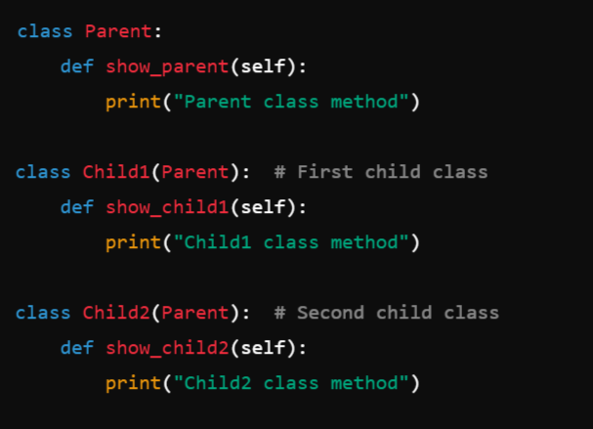
4. Hierarchical Inheritance:
In hierarchical inheritance, multiple child classes inherit from the same parent class.
Example:

Slide 35
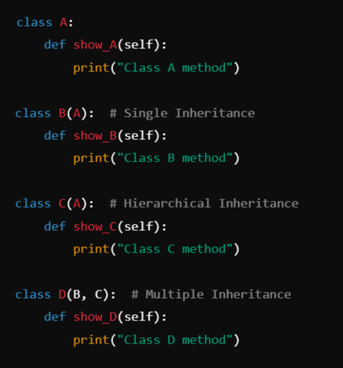
Hybrid Inheritance:
A combination of two or more types of inheritance is called hybrid inheritance.
Example:
D inherits from both B and C, which in turn inherit from A, forming a hybrid inheritance structure.

Slide 36
Multiple Inheritance in Python:
Yes! Python fully supports multiple inheritance, allowing a class to inherit from more than one parent class as compared to Java which doesn’t support Multiple Inheritance. However, this can lead to method resolution order (MRO) conflicts if not managed properly.
Method Resolution Order (MRO):
When multiple classes have the same method, Python follows C3 Linearization (MRO algorithm) to determine which method gets called.

Slide 37
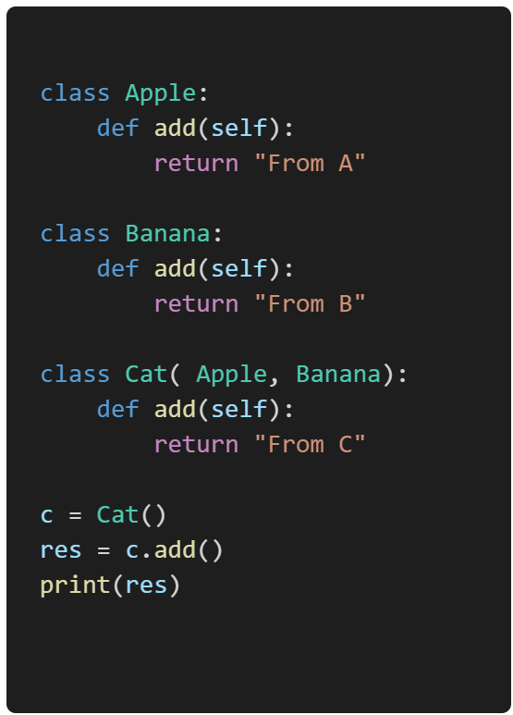
Example:
Output:
From C

Slide 38
Poly-morphism:
Poly - many
Morphism – forms
Types of Polymorphism:
Compile Time (Early Binding)
Method Overloading
Operator Overloading
Constructor Overloading – Not supported in Python
Run Time: (Late Binding)
Method Overriding

Slide 39
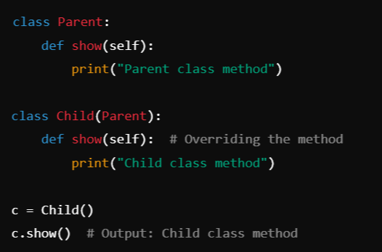
Method Overriding in Inheritance:
If the child class has a method with the same name as a method in the parent class, the child class method overrides the parent class method.
Example:

Slide 40
Rule for Method Overriding:
There should be a Inheritance
Both Parent and Child should have a same method name

Slide 41
Overloading:
Overloading allows multiple methods in the same class to have the same name but work with different parameters or different data types.
Python supports two types of overloading:
Method Overloading (Not directly supported but can be achieved)
Operator Overloading (Using __magic__ methods)

Slide 42
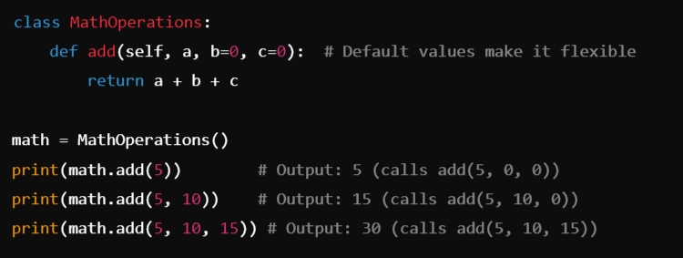
1️⃣ Method Overloading in Python:
Python does not support traditional method overloading (like Java or C++) because it does not allow multiple methods with the same name but different parameters. Instead, we can achieve similar behavior using default arguments or *args.
Example: Using Default Arguments

Slide 43
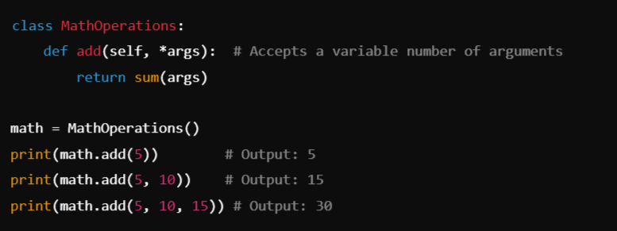
Example: Using *args for Dynamic Arguments:

Slide 44
2️⃣ Operator Overloading in Python:
Python allows us to overload operators (like +, -, *, etc.) using magic methods (Dunder methods).
Common Magic Methods for Operator Overloading:
Operator | Method Name
+ (Addition) | __add__(self, other)
- (Subtraction) | __sub__(self, other)
* (Multiplication) | __mul__(self, other)
/ (Division) | __truediv__(self, other)
% (Modulus) | __mod__(self, other)
== (Equality) | __eq__(self, other)
!= (Not Equal) | __ne__(self, other)
> (Greater than) | __gt__(self, other)
< (Less than) | __lt__(self, other)

Slide 45
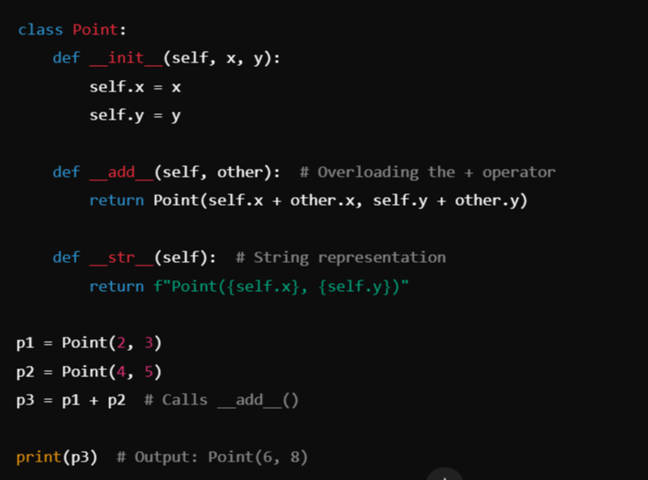
Example:
Overloading the
+ Operator:

Slide 46
4. Abstraction
Abstraction means hiding implementation details and only showing the essential features of an object.
Example: When you drive a car, you use the steering, brake, and accelerator — you don’t need to know how the engine or gearbox works internally.
In Python, abstraction is achieved using:
Abstract Classes
Abstract Methods

Slide 47
Abstract Class
A class becomes abstract if it has at least one abstract method.
A class that cannot be instantiated directly.
It can contain abstract methods (methods without implementation) as well as Concrete methods.
An abstract method is a method that is declared but not implemented in the parent class.
That’s why we cannot create objects of abstract classes.
We use the abc module (ABC and abstractmethod) to create abstract classes.

Slide 48
Abstract Method:
Is a method with no body and it will have only the prototype to the Child class.
And the body or the method implementation will be give by the Child.

Slide 49
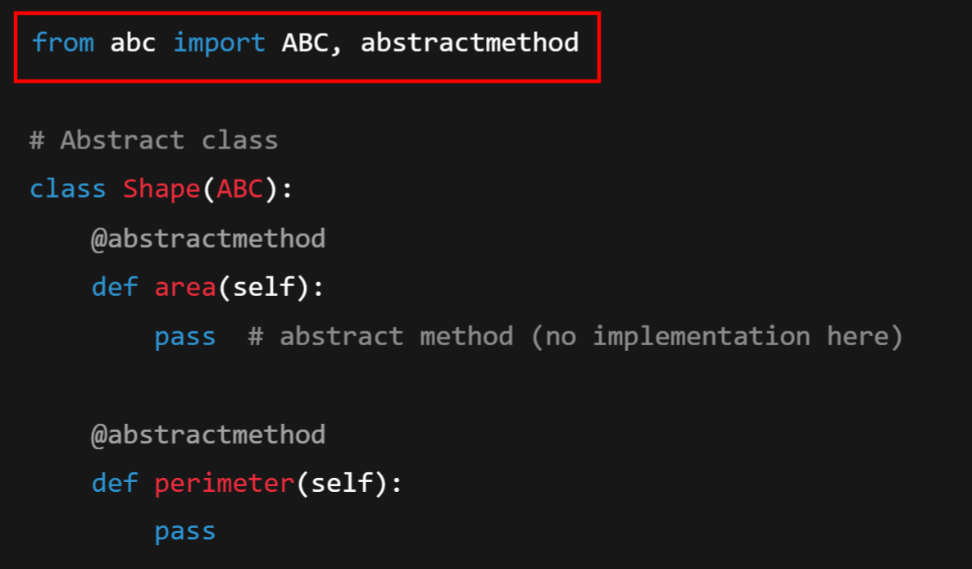
Example:

Slide 50
What and Why do we use the abc module?
Python doesn’t have a built-in keyword like abstract (as in Java or C#).
Instead, Python provides the abc module (Abstract Base Classes).
Inside it, we use:
ABC → A base class to define an abstract class.
@abstractmethod → A decorator to mark a method as abstract.

Slide 51
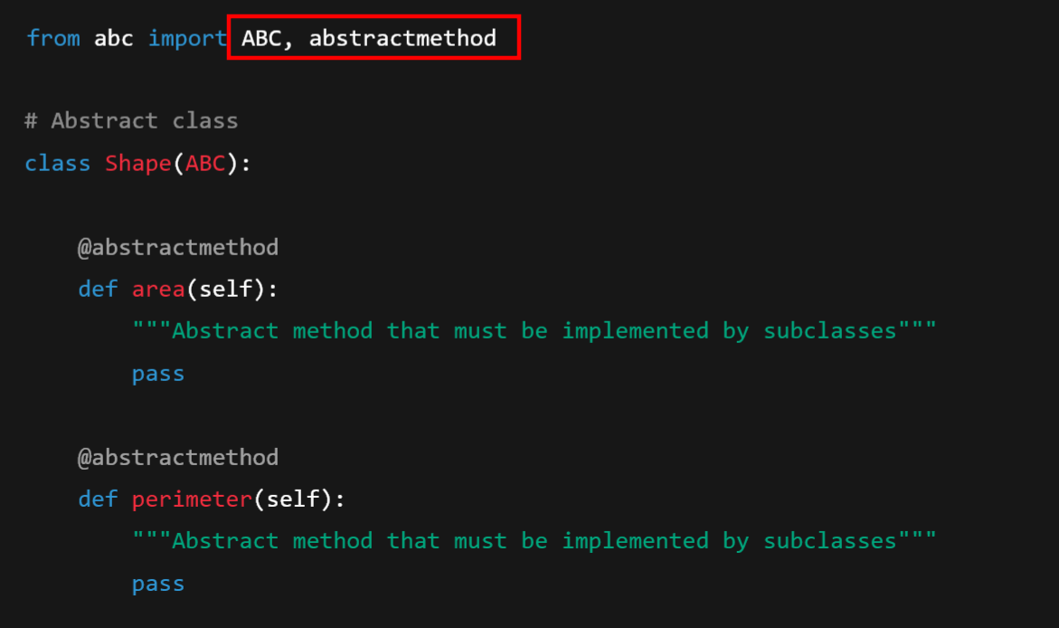
Concrete Class:

Slide 52
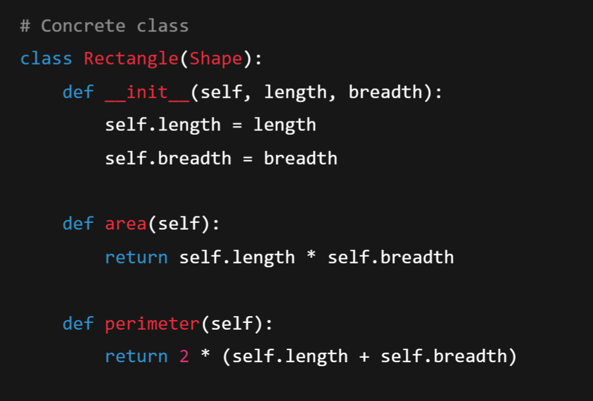

Slide 53
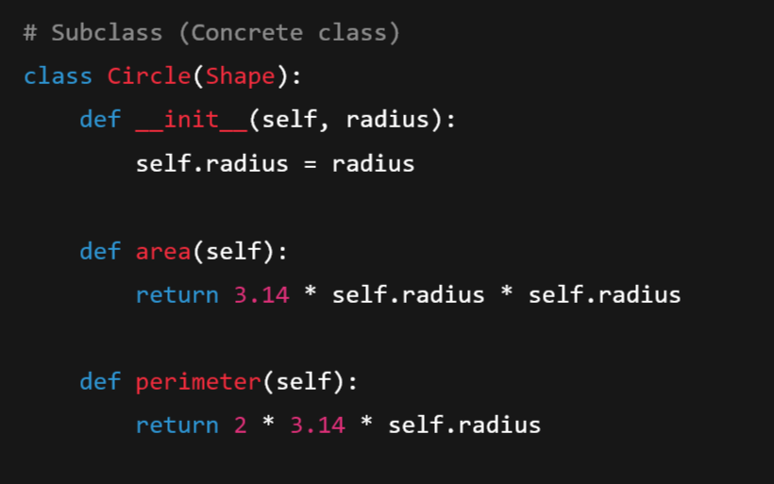

Slide 54
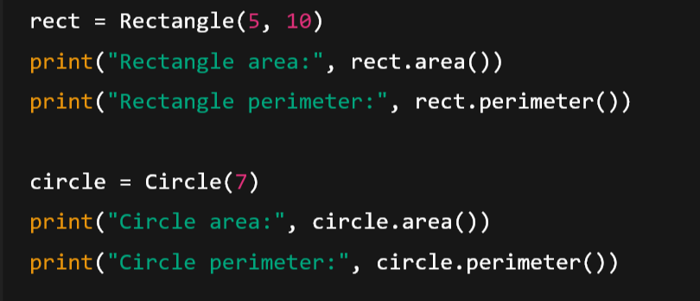
Creating Objects

